Slide 1

SCHOOL OF COMPUTING SCIENCE & ENGINEERING
Subject Name: Project 2 Subject Code: BTCS2453
Heart Disease Detection Using Classification Algorithms
Team Members Detail:
Ashish Tiwari 20SCSE1010517
Aman Mishra 20SCSE1010371
Druv Agnihotri 20SCSE1010027

Slide 2
SCHOOL OF COMPUTING SCIENCE & ENGINEERING
Subject Name: Project 2 Subject Code: BTCS2453
Introduction
Heart disease describes a range of conditions that affect your heart. Today, cardiovascular diseases are the leading cause of death worldwide with 17.9 million deaths annually, as per the World Health Organization reports. Various unhealthy activities are the reason for the increase in the risk of heart disease like high cholesterol, obesity, increase in triglycerides levels, hypertension, etc. There are certain signs which the American Heart Association lists like the persons having sleep issues, a certain increase and decrease in heart rate (irregular heartbeat), swollen legs, and in some cases weight gain occurring quite fast; it can be 1-2 kg daily .All these symptoms resemble different diseases also like it occurs in the aging persons, so it becomes a difficult task to get a correct diagnosis, which results in fatality in near future.

Slide 3
SCHOOL OF COMPUTING SCIENCE & ENGINEERING
Subject Name: Project 2 Subject Code: BTCS2453
Introduction
Python is most powerful programming language having numerous libraries which is used in this project with machine learning model. Machine learning is a subset model of artificial intelligence network in which uses complex algorithms and deep learning neural networks. Cardio vascular disease is a widespread disease in all over a region. This type of disease may cause due to smoking, high blood pressure, diabetes, overweight, hyper tension, cholesterol etc. that has to be accumulated because of the fatty foods or unlimited intake of foods or non-moving to anywhere.

Slide 4
SCHOOL OF COMPUTING SCIENCE & ENGINEERING
Subject Name: Project 2 Subject Code: BTCS2453
Functionality/Working of Project
(i.) Data collection
Overall process of predicting heart disease carries following procedure:
We have collected data from dataset provider –Kaggle.com. The dataset which is published as in the title of Heart Disease dataset .The dataset collected consists of 1024 records of patients, data carries 14 features.
Dataset is the information or a tool essential to do any kind of research or a project.
(ii.) Data Analysis
This , process involves studying the attributes and features of the dataset and analyzing their correlation with each other.
Further, in this process we find out the different measures of statistics and also describe the dataset and analyze it on the basis of the different first few and last few tuples of the whole dataset.
Now the attributes which are used in this project are described as follows and for what they are used or resemble:

Slide 5
SCHOOL OF COMPUTING SCIENCE & ENGINEERING
Subject Name: Project 2 Subject Code: BTCS2453
Data Analysis
(i)Age—age of patient in years.
(ii)sex—(1 = male; 0 = female).
(iii)Cp—chest pain type.
(iv)Trestbps—resting blood pressure (in mm Hg on admission to the hospital)
(v)Chol—serum cholesterol shows the amount of triglycerides present
(vi)Fbs—fasting blood sugar larger than 120 mg/dl (1 true).
(vii)Restecg—resting electrocardiographic results.
(viii)Thalach—maximum heart rate achieved. The maximum heart rate is 220 minus your age.
(ix)Exang—exercise-induced angina (1 yes).
(x)Oldpeak—ST depression induced by exercise relative to rest.
(xi)Slope—the slope of the peak exercise ST segment.
(xii)Ca—number of major vessels (0–3) colored by fluoroscopy.

Slide 6
SCHOOL OF COMPUTING SCIENCE & ENGINEERING
Subject Name: Project 2 Subject Code: BTCS2453
(iv.) Data Preprocessing
Segregation of target data and feature data as training and test data.
Scaling the values in the data to be values between 0 and 1 in which and scale all the values before training the Machine Learning models.
(v.) Applying Algorithms
Comparing 5-machine learning algorithms such as Logistic Regression, Decision tree, Random forest classifier and K- nearest neighbor & MLP as well ,to get the better accuracy to which highest parameter may cause disease.
For each algorithm, there is a pseudo code helpful to develop any kind of programming language. In python, there is a simple way to establish any kind of algorithm in which simple and short code easier to predict accuracy.

Slide 7
SCHOOL OF COMPUTING SCIENCE & ENGINEERING
Subject Name: Project 2 Subject Code: BTCS2453
Machine Learning Algorithms:
The algorithms used in this project is highly helpful to predict the accurate result to detect heart disease in which factors that cause a disease can be detected. The following algorithms have built in this project.
K-Nearest Neighbor algorithm: KNN is a supervised classifier that carry-outs a observations from within a test set to predict classification labels. KNN is one of the classification technique used whenever there is a classification. It has a few assumptions includes dataset has little noise, labeled and it should contains relevant features. By applying KNN in large datasets takes long time to process. The accuracy gained with this algorithm is 79 %.
Random Forest Classifier: Random forest classifier is a powerful tool in the machine learning library. With this classifier, we will be able to get higher accuracy and training time should be less. Initially, we have to build a model and by splitting variables into training and test set. After splitting the data, train the dependent variables and predict the response. By using the random forest classifier, the accuracy predicted result is of 100 %.

Slide 8
SCHOOL OF COMPUTING SCIENCE & ENGINEERING
Subject Name: Project 2 Subject Code: BTCS2453
Decision tree classifier: In this algorithm, preprocessing made initially by splitting data into training and test data .Feature scaling can be done because of normalizing the values before prediction. Import a decision tree classifier to fit the training sets of dependent and independent variables in which Gini-index criterion is used to predict the accuracy or response for the test set. The accuracy gained with this algorithm is 90 %.
Logistic Regression: This algorithm is one of the most popular Machine Learning algorithms, which comes under the Supervised Learning technique. It is used for predicting the categorical dependent variable using a given set of independent variables. Logistic regression predicts the output of a categorical dependent variable. The accuracy gained with this algorithm is 92 %.
MLP: Multi-layer Perceptron (MLP) is a supervised learning algorithm that learns a function f ( ⋅ ) : R m → R o by training on a dataset, where is the number of dimensions for input and is the number of dimensions for output. The accuracy gained with this algorithm is 75 %.

Slide 9
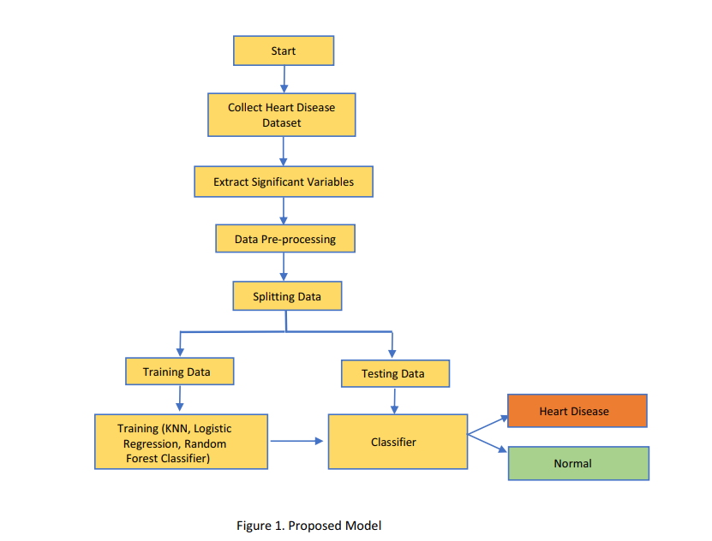
SCHOOL OF COMPUTING SCIENCE & ENGINEERING
Subject Name: Project 2 Subject Code: BTCS2453

Slide 10
SCHOOL OF COMPUTING SCIENCE & ENGINEERING
Subject Name: Project 2 Subject Code: BTCS2453
THANK YOU

